Slide 1
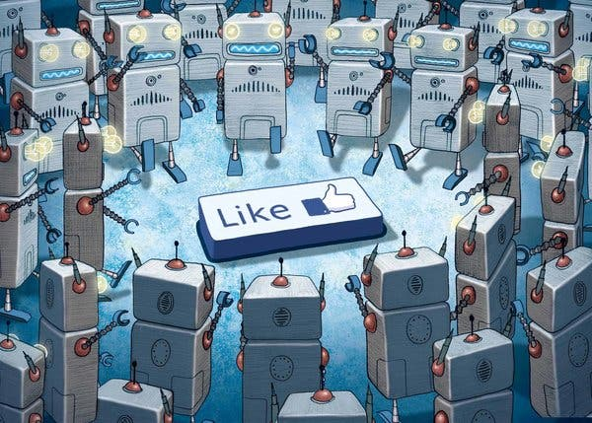
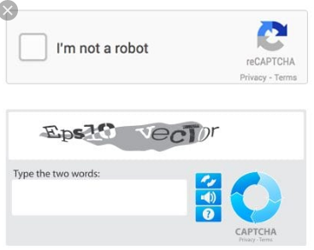
Social Media - AI Bots
20% of Twitter Traffic (estimated)
Similar figures for other applications
Bots simulate real user accounts
AI Bots are created to:
Generate posts or other content
Generate inflated "likes" or "followers"
AI Bots are created by:
Special interest groups (misinformation)
Businesses (a new form of advertising)
Governments (social control)
Purpose is to influence decisions / attitudes
Theory: "If something is repeated, people will believe it"
Influence shopping & business choices
Influence elections & political debates
Limit free speech by confusing legitimate messages

Slide 2
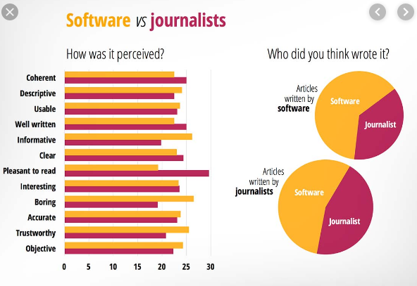
AI Automated Journalism
A growing amount of text content is being written by AI bots:
Web content (short articles)
News stories (New Your Times, etc.)
Business Reports (BNN, etc.)
Reasons for AI Journalism
Speed / Productivity (24 hour news cycle)
Cost / Efficiency (Don't have to pay someone)
Objectivity / Accuracy (?)
Concerns regarding AI Journalism
Job Loss (entry level writing positions)
Diversity of Opinion (Only a few companies write AI software)
Objectivity / Accuracy (Deciding what sources to trust)

Slide 3

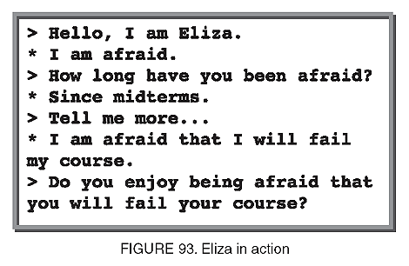
Eliza (1966)
First example of a Natural Language AI
Simulates a On-Line Therapy Session
Proved that a computer had the potential to fool people
URL
http://psych.fullerton.edu/mbirnbaum/psych101/Eliza.htm

Slide 4
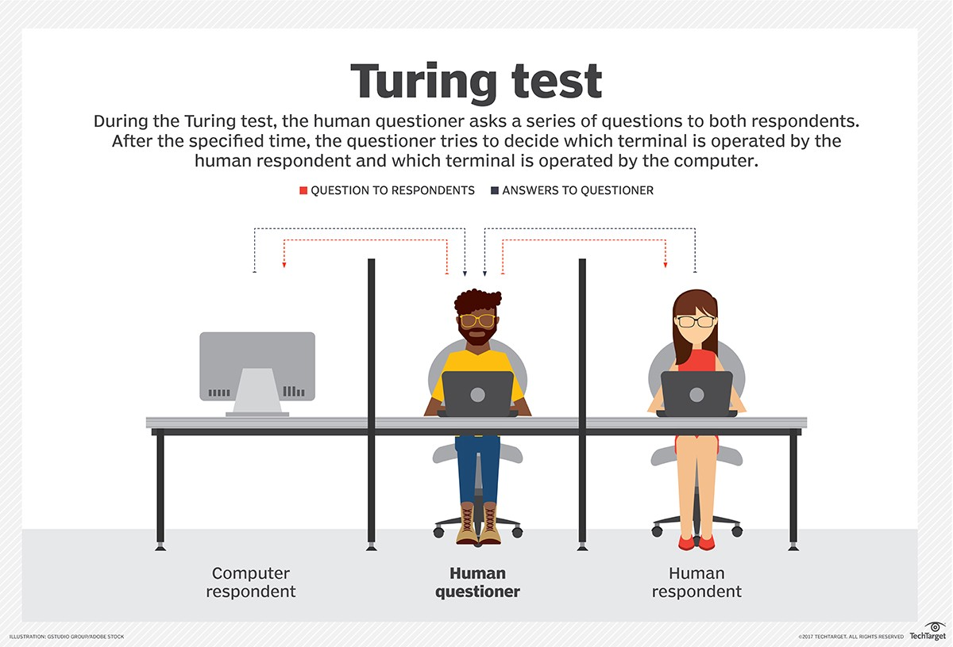
Turing Test (1950)
Developed by Alan Turing (more about him later)
A theoretical test / standard for what would be considered Intelligent
Video
https://ed.ted.com/lessons/the-turing-test-can-a-computer-pass-for-a-human-alex-gendler

